Slide 1
Cloud Basics
Karthick Selvam

Slide 2
Computer
Charles Babbage – 1880 – Calculator to perform basic mathematical operations, Abacus – at earlier days they used to do the mathematical calculations.
In his timeline, he designed some theoretical approach towards working of computers
Computing unit
Input/output
Temp memory / permanent memory
Storage unit

Slide 3
Computing
8080 – 8 bit processor that has been used for computing purpose
8082 - 8bit
8086 – 16 bit processor
Computer doesn’t accept the human language, it understood only binary number
All the binary numbers are calculated by means of bits
Ex : 10*10 – 32 bits of Space that should be available in processor to compute it, once it has been calculated it need to save the result in storage 32 bits
Parallel computing = 32/8, it will do the job in parallel manner

Slide 4
Storage
Punch Card
Floppy Drive
Magnetic Tape
Magnetic Drive
CD/DVD
Portable Drive
SSD(SATA/NVME)

Slide 5
Networking
At the beginning era of the computer, they faced lots and lots of issues to transport the data from one end to another end
They used the copper medium to transmit the electrical signals from one end to another end like that they tried to transmit the computer data's also from one end to another end
Computer used digital signals, they tried with 4 pairs of copper wires in the twisted pair medium – LAN cables
LAN – Local area Network – With in KMS range
MAN - Wireless satellite based networks, GPS
WAN – Internet , Intranet

Slide 6
Virtualization
How system works?
We are installation the OS - > it will copy the files from cd/pen drive to some location -> what will be the location?
Why we need boot sector?
What is boot timing?
What will be need of CMOS?
In some computer without having keyboard/Mouse means it wont let you boot, press cntrl + alt + del to restart?

Slide 7



Boot Sector
Windows 10

Slide 8

Booting Process
2. CMOS -> it will make sure all the peripherals(Charles Babbage) are working fine
Storage with MBR
1. BIOS – intermediator to all your hardware peripherals to covert the resources in to software managed
3. With the help of MBR It will point the Boot Sector
4. Copy the contents from Boot Sector to RAM

Slide 9
Virtualization
Is it possible to install multiple OS in the same hardware?
Is it possible to boot both the OS at the same time?
60000 -> how long can I use this hardware for the training purpose – software's keep on updating – Hardware Compatibility
Let say own my company – 60 persons they been using those systems –hardware with out changes(Software Compatibility) 60*50000(2 years)
15 lakh deploy type 1 virtualization 60 VM and give service to all my employees

Slide 10
Virtualization
It will be the software that got capability to create the fake environment to tell lies to OS, that all the require components to satisfy the boot process are physically available.
2 types of Virtualization concepts available there
Type 1
Type 2

Slide 11
Type 2
Its an virtualization concept that depends on software’s, download and install the software’s
It act on top of application layer, if in the case of any high resource utilization on top of OS layer means it will degrade your Apllication layer Performance
Ex: Vmware Workstation, Virtual Box, Vagrant

Slide 12
Type 2
OS2
OS3
OS1
OS2
OS3
OS4
OS1
OS4
Application Layer
Operating System
Kernel

Slide 13
Type 1
HERE we don’t need to download any applications and all, virtualization software itself an OS
Because of no more application layer hierarchy, we can give assurity on performance
Because of tuning option that will be available on base OS, we can give higher performance
Ex: VMware ESXI, Open Shift

Slide 14
Type 1
OS1
OS2
OS3
OS4
Operating System
Kernel

Slide 15
Cloud
If some rental vendor guy, he been approaching your company about to give the rental server, the server we are going to use Type 1 virtualization in 5 lakhs for 2 years means will u accept the deal or not?
If I accept the offer will the server is in my place or your place?
In in the case of server is from vendor premises means will u accept it, because your company deals with banking projects?

Slide 16
Cloud Providers are offering you the computing services over the internet
Computing Services
IAAS – Infrastructure as a Service
PAAS – Platform as a Service
SAAS – Software as a service

Slide 17
Deploy high configuration system and install all those application they required so far in the single system
Deploy standalone system for each and every application for their requirement with satisfied resource and deploy the architecture
Because of huge threats will be there on application and OS wise, instead of risking all those in single server, we can take risk with stand alone
Redundancy will be good always

Slide 18
IAAS
Infrastructure as a Service -> Cloud Providing Company is responsible for underlying hardware and Networking
If you for IAAS as an Option we can use the same system for multiple application deployment and can save cost

Slide 19
IAAS
We are responsible for only the underlying hardware's, if in the case of OS problems and all we wont take care
Templates
CPU
RAM
Storage
Network

Slide 20
PAAS
Platform as a service – they will take care about underlying hardware, OS, Application Configuration, Firewall

Slide 21
Firewall
Application
OS
CPU
RAM
Storage
Network

Slide 22
SAAS
They will give you Application API as an service
Application
OS
CPU
RAM
Storage
Network

Slide 23
Public Clouds
Amazon Web Services -> IAAS
Google Cloud -> PAAS
Azure Cloud -> SAAS
Digital Ocean
Oracle Cloud – (PAAS) -Database
IBM Cloud

Slide 24
Amazon Web Services
EC2 -> IAAS
Elastic Map Reduce - > PAAS
Kinesis -> PAAS
S3 -> PAAS
Lambda - > SAAS
Redshift - > PAAS
GLUE - > PAAS

Slide 25
Hadoop Basics
Karthick Selvam

Slide 26
DATAs
As of the current scenario companies are facing lots and lots of trouble to save and process the data in time
Because of these limitations in storage and computing medium they been found some solution to solve the issue that’s s nothing but Hadoop
While publishing college results on first day 5 hours how slow your database will be?
Your database application got some limitation to server only particular request at particular timing, if u cross those limits sure it wont respond that’s why its very slow

Slide 27
How Hadoop Solve the issue?
Distributed Computing – clustering of multiple machines to perform some task
Clustering can be done via 2 types
Computing – RAM and CPU(10 machines with 2 gb ram and 2 core processor- this mechanism it will make one logical space that will combine all the computing resource in the cluster and show you as single logical unit)
Storage - Hard drive

Slide 28
What is Storage?
Storage is the logical combination of blocks and partitions
What will be the need of File System?
Method of handle those blocks and partitions to effectively store and retrieve the user datas

Slide 29
Min and max volume min and max file size it will support
Fat
Fat32
NTFS
Ext1
Ext2
Ext3
Ext4
OFS

Slide 30
Hadoop
They came up with separate file system concept that will support for distributed mechanism as well as to support the larger volumes of data
HDFS -> Hadoop Distributed File System, only one filesystem that Hadoop will support
HDFS file system that got capability to extend and reduce its size depends upon requirement – Auto Scaling

Slide 31
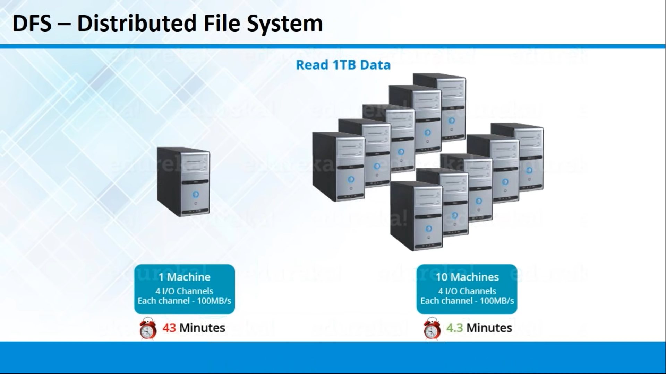

Slide 32
Python
MySQL
Shell Scripting

Slide 33
w

